Slide 1

CRSA MEETING 16th DECEMBER 2015
Jeffrey Ridley

Slide 2
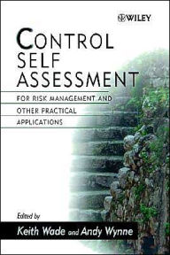
Quality, Governance and Conduct
are important Control Drivers
My Conclusions 1999
“Control objectives for Quality, Governance
and Conduct will continue to integrate and
have an impact on all risks”

Slide 3
“CSA should be integrated with…..
1999
RISK
MANAGEMENT
QUALITY
MANAGEMENT
BUSINESS
PLANNING
CSA
CSA
CONTROL
MANAGEMENT
CONTROL
DESIGN
CSA (1999FIG 1.1)

Slide 4
“CSA should be integrated with…..
2015
RISK
MANAGEMENT
QUALITY
MANAGEMENT
BUSINESS
PLANNING
CSA
INNOVATION
RESPONSIBLE
LEADERSHIP
CSA
CONTROL
MANAGEMENT
CONTROL
DESIGN
GOVERNANCE

Slide 5
“CSA should be integrated with…..
2015
RISK
MANAGEMENT
QUALITY
MANAGEMENT
BUSINESS
PLANNING
CSA
CSA
CONTROL
MANAGEMENT
CONTROL
DESIGN

Slide 6
“CSA should be integrated with…..
2016
RISK
MANAGEMENT
RESPONSIBLE
LEADERSHIP
INNOVATION
CSA
CSA
SUSTAINABILITY
SECURITY
CONTROL
DESIGN
GOVERNANCE
VALUES

Slide 7


Corporate Governance
VALUES

Slide 8

Corporate
Governance
The Laughing Gravy
Restaurant
VALUES
ACCOUNTABILITY
TRANSPARENCY
OPENNESS
OBJECTIVITY
HONESTY
LEADERSHIP

Slide 9
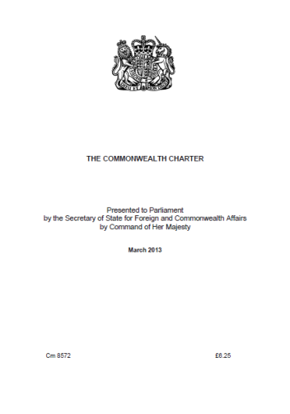




A New Era of
UN Global Compact-Accenture (2010)
St. Petersburg Research Paper 2010
SUSTAINABILITY
YES NO
CONTROL AUDIT
MANAGE ASSURANCE
RISK COMPLY
ASSESS INSPECT
GOVERN
MANAGE
MONITOR
MEASURE
REGULATE
REPORT
2005
2012
2013
2013
2015
2010

Slide 10
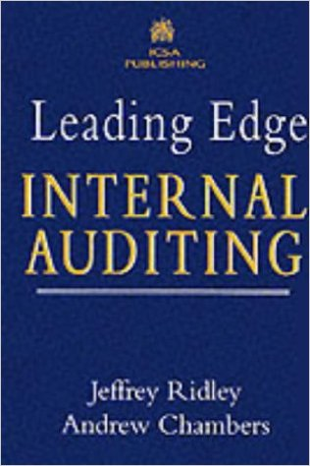
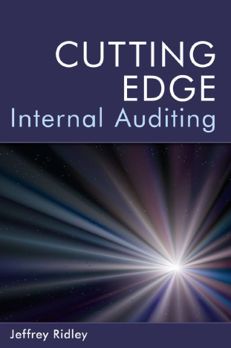
Creative Thinking and in Auditing (2016)
INNOVATION
1998
2008
Auditors
are:
Leaders (Responsible)
Protectors
Ambassadors
Time Travellers
Futurists
Scientists
Doctors
Lawyers
Facilitators
Explorers
Standard Bearers
Benchmarkers

Slide 11
Ridley/D’Silva Research 2007
“The pattern that tends to emerge from the research in relation to current U.K. Internal Audit innovation is one that suggests higher attention in terms of innovation is being paid to quality and efficiency with LESS ATTENTION BEING DEVOTED TO THE EXPANSION OF SERVICES …. (Innovative Practices in Today’s Internal Auditing, Pisa, Italy)

Slide 12
Ridley/D’Silva Research 2012
Developing COLLABORATIVE ‘OPEN INNOVATION’ TEAMS may be the way forward for all internal audit departments to be creative in their roles and continuous improvement in their practices. CROSS FUNCTIONAL COMMUNITIES OF PRACTICE probably exist or can be developed in every organization: and, externally….
(Creativity and Innovation: Keys to a successful future for Internal Auditing, Verona, Italy)

Slide 13
GOVERNANCE SYMBOLS
1 OWNERS/STAKEHOLDERS
2
+
3
4

Slide 14

RESPONSIBLE
LEADERSHIP
INNOVATION
QUESTIONS
SUSTAINABILITY
SECURITY
GOVERNANCE
VALUES

