Slide 1
CRSA User Group/Forum 20 years on!
Darryl Clark
(Founder & former Chair – “UK CRSA User Group”)

Slide 2
Once upon a time ............
There was a new auditing technique called “CSA”
There was lots of risk & control specialists interested
It was receiving international acclaim
And there was lots of seminars & conferences around – all packed to the rafters
BUT ...
There were very few, a handful, of actual users
Their views were crowded out by the throng of non-users
And they had no-one to talk to.

Slide 3
The “UK CSA User Group”
Formed in January 1995
8 members
Members were internal auditors
Met quarterly
Very informal
Formal goals and objectives
Practitioners only

Slide 4
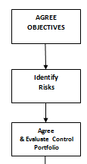
UK CSA User Group: original model

Slide 5
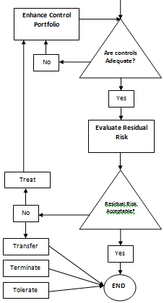
UK CSA User Group: original model

Slide 6
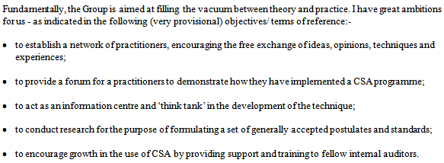
UK CRSA User Group: original objectives
Extract from Letter dated 30 January 1995

Slide 7
Mapping of Objectives 1995 - 2015
They’ve proved reasonably enduring ......
CRSA Forum today:-
5. acting as a catalyst for new ideas
2. share diverse approaches and experiences

Slide 8
Mapping of Objectives 1995 - 2015
CRSA Forum today:-
3. identify and develop best practices
5. acting as a catalyst for new ideas

Slide 9
Mapping of Objectives 1995 - 2015
CRSA Forum today:-
2. share diverse approaches and experiences
5. acting as a catalyst for new ideas

Slide 10
Mapping of Objectives 1995 - 2015
CRSA Forum today:-
4. provide a resource for CRSA users

Slide 11
Mapping of Objectives 1995 - 2015
CRSA Forum today:-
4. provide a resource for CRSA users

Slide 12
Mapping of Objectives 1995 - 2015
What we didn’t have that you now do .....
“1. promote the value and benefits of CRSA in corporate governance, enterprise risk management and organisational improvement”
“6. collaborate with relevant professional bodies”

Slide 13
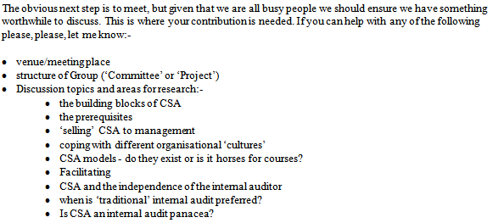
What did we talk about?
Extract from the same letter .....

Slide 14
Inaugural meeting: Agenda
Welcome
- reminder of why we are here, purpose of the Group
- Attendees & Membership
- Observation Aids
Objectives & aims
- Discuss, develop, synthesise & agree
Presentation by Dave Gammon of Grand Metropolitan (formerly from Tesco)
- followed by Questions Time
Long lunch!
July survey results
News/Updates
- New book on CSA
- My move - handout stickers
Round table
Format for future meetings
- CSA presentation? Offers?
- Facilitated discussion around a particular interest area?
- Formation of special interest working groups?
- Venue. Offers?
- Date of next meeting

Slide 15
We used an “Observation Aid”!

Slide 16
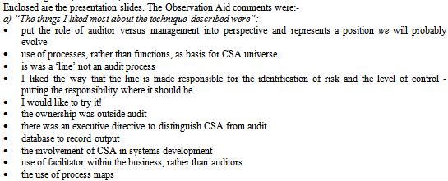
We used an “Observation Aid”!

Slide 17
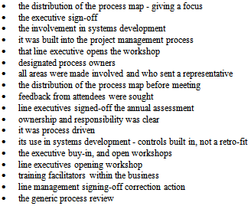
We used an “Observation Aid”!

Slide 18
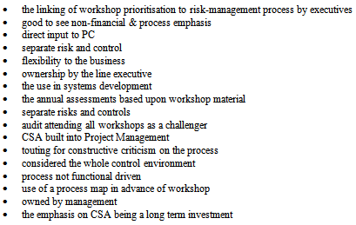
We used an “Observation Aid”!

Slide 19
We used an “Observation Aid”!

Slide 20
We used an “Observation Aid”!

Slide 21
CRSA: back to basics ....
Core principles:
It’s participative
It’s collaborative
Requires strong facilitation skills (audit/risk as control experts)
The business must own the outputs
Audit/risk do not own the results – but may report them
It’s periodic not continuous – or for special needs
It’s fuzzy – too much ’perfection-ising’ destroys it.
Success = audit/risk’s role demoted to verifying the quality of the CRSA process

Slide 22
Does CRSA have a role to play today?
Financial services & EU Solvency II Directive (wef 1/1/16)
Article 41(1):
“The system of governance shall be subject to regular internal review.”
Article 45(1):
“As part of its risk-management system every insurance undertaking and reinsurance undertaking shall conduct its own risk and solvency assessment” = Own Risk & Solvency Assessment (“ORSA”)
Article 45(4) :
“The own-risk and solvency assessment shall be an integral part of the business strategy and shall be taken into account on an ongoing basis in the strategic decisions of the undertaking.”

Slide 23
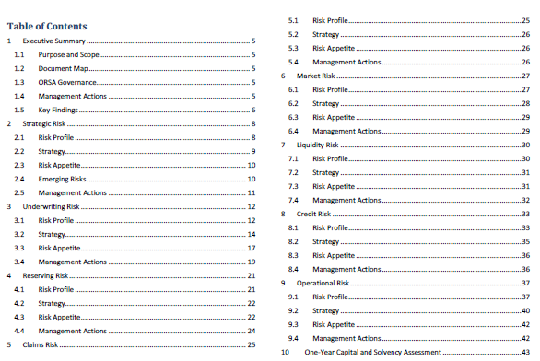
What does “self-assessment” mean and entail today?

Slide 24
Does CRSA have a role to play today?
ERM & CRSA - a perfect match
ISO 31000 – Risk Management: Definition of risk:
“The risk of uncertainty on objectives”
CRSA begins with objectives – unlike many/most other risk approaches
ERM requires an assessment of all the organisation’s moving parts - whilst they are all moving!

Slide 25
Does CRSA have a role to play today?
Processes
Departments
Staff
Management
Stakeholders
Customers, Products & Markets
Locations/
branches/countries
ERM!

Slide 26
Does CRSA have a role to play today?
Processes
Departments
Staff
Management
Stakeholders
Customers, Products & Markets
Locations/
branches/countries
CRSA principles
Participative
Collaborative
Ownership, and/or
TEAM-BASED?
ERM!

Slide 27
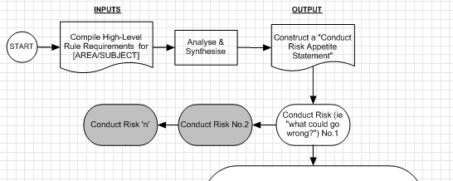
Does CRSA have a role to play today?

Slide 28
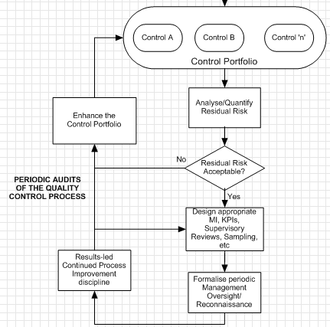
Does CRSA have a role to play today?
(No “END” node)

Slide 29
Last slide ....
Observation
Opportunity?
CRSA has survived!
‘Facilitated workshops’ appear to have faded
Principles accord with modern management ‘style’
Regulators are making increasing demands for internal ‘assessments’
Corporate governance is today a way of life
ERM needs a solution to ‘hugging air’
CRSA is there waiting & ready to be used
A tool to ignite a resurgence in CRSA?
Resistance should be minimal
CRSA is a much-needed solution to those who’ve never heard of it
CRSA is in itself evidence of a sound governance culture
CRSA is primed to come to the rescue!

Slide 30
CRSA – 20 Years on
Darryl Clark ACIS, PIIA, MSC, MA, PGDip
Managing Director
Panacea Compliance Ltd - Regulatory Consultancy & Training Specialists
Contact: Darryl Clark
Email: dclark@panaceacompliance.co.uk
Mobile: 07818 000 282
Tel: 01202 692 703

