Slide 1
An alternative to command and control?

Slide 2
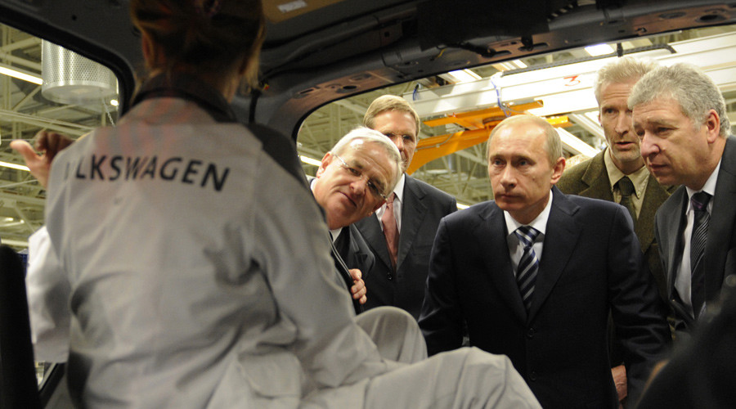
An alternative to command and control?

Slide 4
I am aware of nothing going on in our team or elsewhere in the organisation which might cause embarrassment to the organisation
I strongly disagree
I disagree
I slightly disagree
I neither agree nor disagree
I slightly agree
I agree
I strongly agree
Answers at CIPFA audit conference May 2015
paul moxey ©

Slide 5
An alternative to command and control?

Slide 6
http://www.reinventingorganizations.com/uploads/2/1/9/8/21988088/140305_laloux_reinventing_organizations.pdf

Slide 13
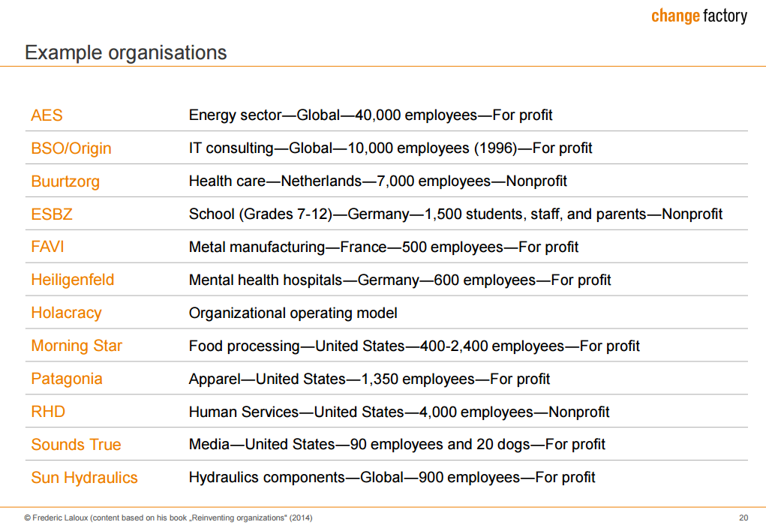

Slide 18
For further discussion
Paul Moxey
paul@moxey.co.uk

